Slide 1
Generalized IPv6 for VXLAN/GRE
Qiangzhou Gao

Slide 2
VXLAN and GRE需要扩展支持新特性
VXLAN and GRE有两种方式
1. VXLAN和GRE各自扩展
2. VXLAN和GRE用现有IPv6封装
推荐Option 2；IPv4不再考虑扩展。

Slide 3
GIP6 Technical Description
The Generalized IPv6 (GIP6) tunnel is defined to use the IPv6 header and IPv6 extension header to support both existing IP tunnels functions and new features.
A GIP6 encapsulated packet has the following format:
Option 1 (Recommended)
+ - - - - - - - - - - - - - - - - - - - - - - - - - - - - - - - - - - - +
| IPv6 Header |
+ - - - - - - - - - - - - - - - - - - - - - - - - - - - - - - - - - - - +
| IPv6 Extension Header |
| (Encapsulations of new features + |
| Encapsulations of functions of existing IP tunnels) |
+ - - - - - - - - - - - - - - - - - - - - - - - - - - - - - - - - - - - +
| Payload packet |
+ - - - - - - - - - - - - - - - - - - - - - - - - - - - - - - - - - - - +
Option 2
+ - - - - - - - - - - - - - - - - - - - - - - - - - - - - - - - - - - - +
| IPv6 Header |
+ - - - - - - - - - - - - - - - - - - - - - - - - - - - - - - - - - - - +
| IPv6 Extension Header |
| (Encapsulations of new features) |
| |
+ - - - - - - - - - - - - - - - - - - - - - - - - - - - - - - - - - - - +
| Existing IP Tunnel Headers |
+ - - - - - - - - - - - - - - - - - - - - - - - - - - - - - - - - - - - +
| Payload packet |
+ - - - - - - - - - - - - - - - - - - - - - - - - - - - - - - - - - - - +
GIP6 Encapsulation
GIP6 Encapsulation

Slide 4
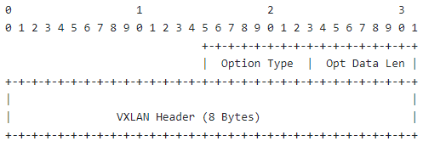
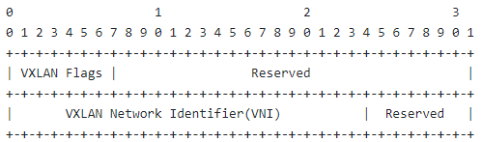
GIP6 for VXLAN
1. The function of the UDP is replaced by the flow label of the IPv6 header in the GIP6 tunnel. To ensure compatibility, the value of the flow label calculated for the purpose of ECMP SHOULD be the same as that of the source port of the UDP.
2. Definition of the VN Option
A new option called VN Option is defined to carry the VXLAN header information. The VN Option MUST only be encapsulated in the Destination Options Header (DOH).
VN Option
VXLAN headers

Slide 6

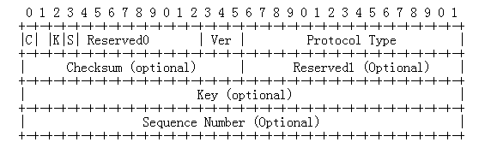
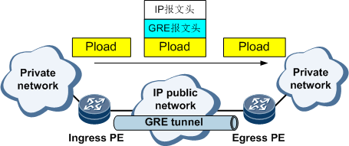
GIP6 For GRE
Application scenario: GRE encapsulates packets of one network layer protocol into packets of another network layer protocol for transmission. Tunnels are recommended in the SD-WAN solution and are usually used together with GRE over IPSec.
When the system receives the data of a certain network layer protocol that needs to be encapsulated and routed, it adds a GRE header to the data and encapsulates the data in another protocol, such as IP. In this way, the IP protocol is responsible for forwarding the packet.
Passenger protocol: The packet protocol before encapsulation is called passenger protocol.
Encapsulation Protocol (Encapsulation Protocol): The foregoing GRE protocol is called the encapsulation protocol, also called the carrier protocol (Carrier Protocol).
Transport protocol (Transport Protocol or Delivery Protocol): A protocol that forwards encapsulated packets is referred to as a transport protocol.
Restriction 1:
The Key field is short and has poor scalability.
Restriction 2:
The keepalive, mtu, and path mtu mechanisms are defined, which increases the complexity.
Restriction 3:
Extension of new features is not supported.
After receiving the private network packet from the interface connected to the private network, the ingress PE performs GRE tunnel encapsulation.
The egress PE receives the packet from the interface connected to the public network and analyzes the IP header. The egress PE finds that the destination address of the packet is the local device and the protocol field value is 47, indicating that the protocol is GRE (see RFC 2784). Then, the egress PE performs GRE decapsulation and removes the IP header and GRE header. Then, based on the Protocol Type field in the GRE header, the finds that the passenger protocol of the packet is IP. Then, the searches the routing table for the private IP address and forwards the packet.
Notes:
给V4升级V6的建议
切片： ipv6 扩展头定义了相关信息
隧道： MPLS 。。。。 没有IPv6头确实难以支持
GRE， VxLan
陈双龙(00419335)2022-10-28 10:22 疑惑点1. 既然IPv6头已经定义了 切片、apn、ioam等， 隧道直接用IPv6 头的这些信息就完了， 隧道为什么还要扩展定义一下呢？（单域和跨域 貌似都没有这种需求） 李振斌(00392056)2022-10-28 10:24 事实上不是这么简单，因为本来就有两种选择，可以直接在隧道头后面扩展，没有人规定这些IPv6信息可以直接用的。 李振斌(00392056)2022-10-28 10:25 而在隧道头上扩展是通用的实现方法，因为这样保证IPv4和IPv6一致。
Pv4 还需要支持切片吗， 李振斌(00392056)2022-10-28 10:26 支持啊。园区现在就是要支持切片，而且基本上所有园区都是IPv4的。 陈双龙(00419335)2022-10-28 10:36 问了董杰，确实vxlan头里 扩展支持了 切片 陈双龙(00419335)2022-10-28 10:37 澄清一个应用场景： 对于单栈 IPv4的网络 GIP6 是不是 没有用武之地。 只能作为 payload 穿越 陈双龙(00419335)2022-10-28 10:41 也就是说既然园区基本都是IPv4的， 我们GIP6 似乎也无法应用于 园区这种纯 IPv4的 网络场景。 您撤回了一条消息 陈双龙(00419335)2022-10-28 10:43 除非 GIP6 的信息，放到报文payload里，也传递到让园区IPv4设备上， 让这些设备支持再深入处理获得这些信息。 陈双龙(00419335)2022-10-28 10:44 或者： 推动 IPv4 网络 升级成 IPv6 网络

Slide 7
GIP6两种扩展比较
Option 2：兼容性好，但是功能分离（分别由IPv6 Extension Header和隧道头携带不同的信息）。
Option 1：兼容性差，但是功能集中（统一由IPv6 Extension Header携带）
。

Slide 8
Generalized IPv6 for MPLS
Zhenbin Li

Slide 9
Technical Challenges to MPLS
MPLS is lack of the source indication and MP2P connections may occur. This causes the difficulty and complex process for OAM over MPLS. Although SFL( [RFC8957]) is defined, there is few implementation.
The payload type (for example, L2 or L3 packets) cannot be directly determined because there is no payload indication.
There is no metadata extensibility and it is difficult to encapsulate new forwarding attributes for the new features such as IETF network slicing, IFIT, and APN.
The process of the ECMP function is complex and affects forwarding performance. Entropy labels or flow labels are placed at the bottom of the label stack for processing and the internal IP header information may have to be parsed for the purpose of ECMP.
MPLS Label Encap
Label
TC
S
TTL
20
bits
3
bits
1
bit
8
bit

Slide 10
MPLS Extensions
MPLS needs to be extended to support new functionalities.
Network Slicing
IOAM
DetNet
APN
MPLS Extensions
ISD: In-stack data
PSD: Post-stack data
Challenges
It is not compatible with the existing MPLS network.
Repeated work like the IPv6 extension mechanisms.
Tunnel Label 1
…
Tunnel Label m
Sub-stack Indicator
Network Action indicator
+
Optional Ancillary Data
ISD
NAS
Tunnel Label n
VPN Label （S=1）
PSD
Network Action indicator
+
Optional Ancillary Data
Payload

Slide 11
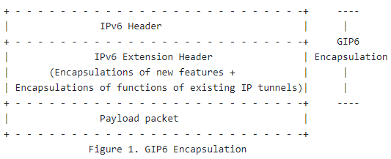
GIP6 tunnel for MPLS
Draft-li-rtgwg-generalized-ipv6-tunnel defines the GIP6 tunnel to support both new features(iOAM/APN…) and the existing functions for the IP tunnels based on the extension of the IPv6 extension header.
If the GIP6 tunnel is used for MPLS, there can be the following advantages:
1. The IPv6 source address is used to form a source identifier.
2. The IPv6 NH can indicate the payload type.
3. IPv6 flow labels are used to implement ECMP.
4. The encapsulations for the new features have been defined well in the IPv6 and can be reused easily.

Slide 12
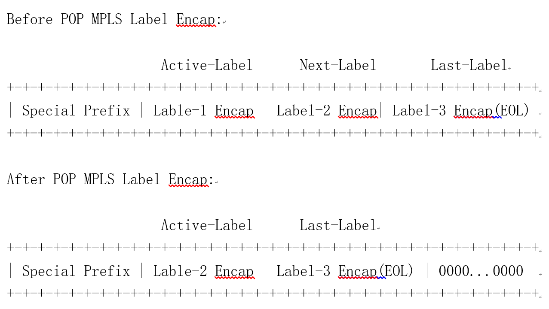
IPv6 MPLS SID(Type 1) can be placed in the IPv6 destination address
Processing of the first label following the special prefix is as follows:
(1) If the local action of the MPLS label is POP, the followed label encapsulations are shifted left by 32 bits after the label is popped. The following figure shows the process.
(2) If the local action of the MPLS label is SWAP, the label encapsulation is changed to the new label after swap.

Slide 13
IPv6 MPLS SID(Type 2) can be placed in the IPv6 RH
If all the MPLS label stack cannot be placed in the IPv6 destination address, IPv6 RH can be used to house the remaining MPLS label stack.
(1) IPv6 MPLS SID (Type 2) is defined to house multiple (<= 4) label encapsulations. The format of the IPv6 MPLS SID (Type 2) is shown in the following figure.
0 1 2 3
0 1 2 3 4 5 6 7 8 9 0 1 2 3 4 5 6 7 8 9 0 1 2 3 4 5 6 7 8 9 0 1
+-+-+-+-+-+-+-+-+-+-+-+-+-+-+-+-+-+-+-+-+-+-+-+-+-+-+-+-+
| MPLS Label Encap (4 octets) |
+-+-+-+-+-+-+-+-+-+-+-+-+-+-+-+-+-+-+-+-+-+-+-+-+-+-+-+-+
| MPLS Label Encap (4 octets) |
+-+-+-+-+-+-+-+-+-+-+-+-+-+-+-+-+-+-+-+-+-+-+-+-+-+-+-+-+
| MPLS Label Encap (4 octets) |
+-+-+-+-+-+-+-+-+-+-+-+-+-+-+-+-+-+-+-+-+-+-+-+-+-+-+-+-+
| MPLS Label Encap (4 octets) |
+-+-+-+-+-+-+-+-+-+-+-+-+-+-+-+-+-+-+-+-+-+-+-+-+-+-+-+-+
(2) IPv6 MPLS SID (Type 2) is used as the segment in the RH. After all of the label encapsulations in the IPv6 destination address are popped, the first label encapsulation in the segment indicated by the SL of the RH will be processed.

Slide 14
Thank You

